Slide 1
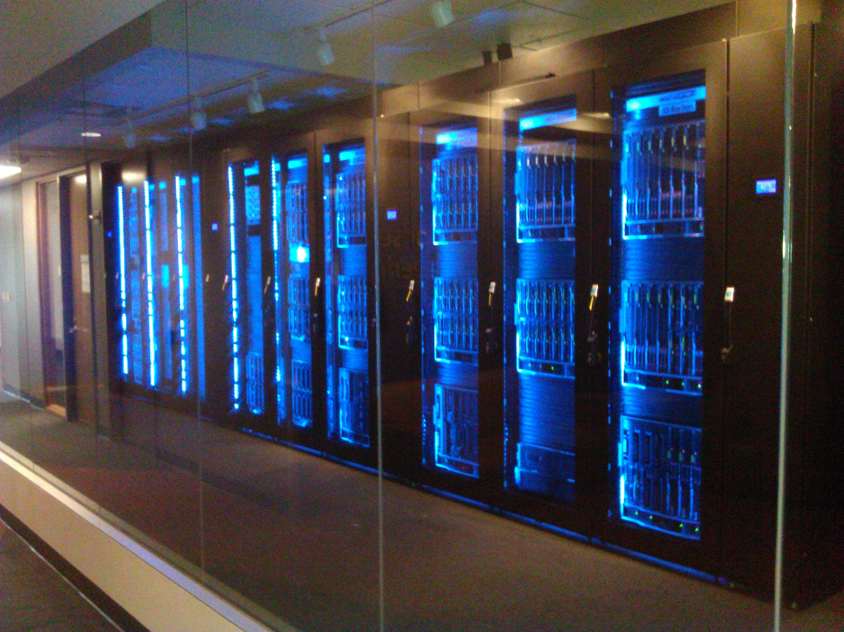

Microsoft MPP Data Warehouse(s)
DR Solution for APS to SQLDW
#MSMPPDWH

Slide 2

Agenda

Slide 3

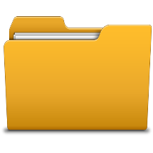

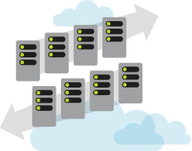
Normal Activity
Landing Zone Server - Prod
Step 1: Source System Extract
Load (SSIS)
Step 2: DFS Replication
Extract (SSIS)
Step 3: PDW Load
Landing Zone Server - DR
Step 4: Verification / Notification / Clean up
Extract (SSIS)
Load (SSIS)

Slide 4
Normal Activity - Source System Extract
Step 1: SSIS reads configuration table to determine data to be extracted
Landing Zone Server - Prod
Step 2: SSIS Extracts Data from Source system and Places it on DFS
09/03/2013 8:36:00
Step 3: SSIS Creates Record in ETL Control Detail Table with Status of New
Step 4: SSIS Records Last Extract Date
Proc20130903a
Extract (SSIS)
ETL Control Table
ETL Control Detail Table
Landing Zone Server - DR
Extract_Table
FileName
PDWStatus
DRStatus
Extract_Table
Last_Extract_Date
Status
Patient
09/03/2013 6:37:45
09/03/2013 6:37:45
Patient
Comp
Pat20130903x
Comp
Comp
Procedure
09/03/2013 6:37:05
Procedure
Comp
Proc20130903x
Comp
Comp
Patient
New
Extract (SSIS)

Slide 5
Normal Activity – PDW Processing
Step 5: PDW Load Process reads ETL Control Detail to determine what needs to be completed
Landing Zone Server - Prod
Step 6: Each PDW is loaded with the Data it needs
Step 7: Each ETL Updated the Control Table indicating it processed the File
Load (SSIS)
Step 8: Verification/Notification/Clean up – Based on the ETL Control Detail Table, the DFS folder is cleaned up it all PDW’s have processed the file
Comp
ETL Control Detail Table
Landing Zone Server - DR
Extract_Table
Status
FileName
PDWStatus
DRStatus
Patient
Comp
Pat20130903x
Comp
Comp
Procedure
Comp
Proc20130903x
Comp
Comp
Patient
Pat20130903a
New
Pat20130903a
Pat20130903a
Load (SSIS)
Comp

Slide 6
DR Activity - Source System Extract
Step 1: Load Balancer and IP pointed to DR.
Step 2: SSIS reads configuration table to determine data to be extracted
Landing Zone Server - Prod
Step 3: SSIS Extracts Data from Source system and Places it on DFS
- DFS Fails to Copy to Prod
Step 4: SSIS Creates Record in ETL Control Detail Table with Status of New
Step 5: SSIS Records Last Extract Date
Extract (SSIS)
X
ETL Control Detail Table
Landing Zone Server - DR
ETL Control Table
Extract_Table
Status
FileName
PDWStatus
DRStatus
Extract_Table
Last_Extract_Date
Patient
09/03/2013 6:37:45
09/03/2013 6:37:45
Patient
Comp
Pat20130903x
Comp
Comp
Procedure
09/03/2013 6:37:05
Procedure
Comp
Proc20130903x
Comp
Comp
Patient
New
Extract (SSIS)
Proc20130903a
09/03/2013 8:36:00

Slide 7
DR Activity – PDW Processing
Step 6: PDW Load Process reads ETL Control Detail to determine what needs to be completed
Landing Zone Server - Prod
Step 7: Each PDW is loaded with the Data it needs
Step 8: Each ETL Updated the Control Table indicating it processed the File
Load (SSIS)
Step 9: Verification/Notification/Clean up – Based on the ETL Control Detail Table, the DFS folder is cleaned up if all PDW’s have processed the file
ETL Control Detail Table
Landing Zone Server - DR
Extract_Table
Status
FileName
PDWStatus
DRStatus
Patient
Comp
Pat20130903x
Comp
Comp
Procedure
Comp
Proc20130903x
Comp
Comp
Patient
Pat20130903a
New
Pat20130903a
Pat20130903a
Load (SSIS)
Comp

Slide 8
DR Activity – PDW Processing fail back
Step 6: DFS copies files to Prod
Step 7: PDW Load Process reads ETL Control Detail to determine what needs to be completed
Landing Zone Server - Prod
Step 8: Each PDW is loaded with the Data it needs
Step 9: Each ETL Updated the Control Table indicating it processed the File
– Return to step 7
Step 10: Verification/Notification/Clean up – Based on the ETL Control Detail Table, the DFS folder is cleaned up if all PDW’s have processed the file
Pat20130903a
Load (SSIS)
Comp
Comp
Step 11: Load Balancer is set to point to Prod
ETL Control Detail Table
Landing Zone Server - DR
Extract_Table
Status
FileName
PDWStatus
DRStatus
Patient
Comp
Pat20130903x
Comp
Comp
Procedure
Comp
Proc20130903x
Comp
Comp
Patient
Pat20130903a
New
Pat20130903a
Pat20130903a
Comp
New
Pat20130903b
Pat20130903b
Patient
Pat20130903b
Load (SSIS)
Comp

Slide 9

Process Explained
Source Changes are written to flat files for processing
Files in DFS are picked up periodically by ET process
If a File has never been loaded then it is processed
Loading completes on local PDW
Load is logged in a central Configuration DB
Both PDW’s process the Files and records there process in the Configuration DB
Files loaded at both PDW’s are removed from the DFS files store

Slide 11
© 2014 Microsoft Corporation. All rights reserved. Microsoft, Windows, Windows Vista and other product names are or may be registered trademarks and/or trademarks in the U.S. and/or other countries.
The information herein is for informational purposes only and represents the current view of Microsoft Corporation as of the date of this presentation. Because Microsoft must respond to changing market conditions, it should not be interpreted to be a commitment on the part of Microsoft, and Microsoft cannot guarantee the accuracy of any information provided after the date of this presentation. MICROSOFT MAKES NO WARRANTIES, EXPRESS, IMPLIED OR STATUTORY, AS TO THE INFORMATION IN THIS PRESENTATION.

